Slide 1
Graph Theory
Topic 7 Discussion 2
Ryan Coon

Slide 2
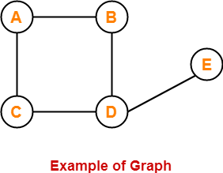
What is Graph Theory?
-A graph is a collection of vertices connected to each other through a set of edges.
-The study of graphs is known as Graph Theory.
A graph is defined as an ordered pair of a set of vertices and a set of edges.
G = (V, E)
Here, V is the set of vertices and E is the set of edges connecting the vertices.

Slide 3
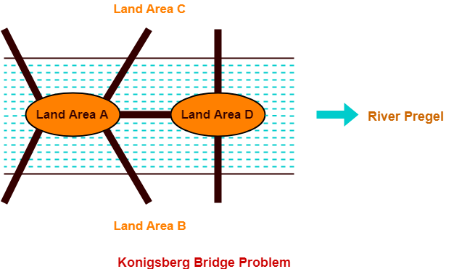
7 Bridges of Königsberg
-Konigsberg is the former name of a German city that is now in Russia.
-The following picture shows the inner city of Konigsberg with the river Pregel.
-The river Pregel divides the city into four land areas A, B, C and D.
-In order to travel from one part of the city to another, there exists seven bridges.

Slide 4
7 Bridges of Königsberg
Konigsberg Bridge Problem may be stated as-
“Starting from any of the four land areas A, B, C, D, is it possible to cross each of the seven bridges exactly once and
come back to the starting point without swimming across the river?”

Slide 5
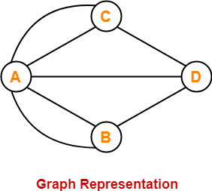
7 Bridges of Königsberg
In 1735, A Swiss Mathematician Leon hard Euler solved this problem.
He provided a solution to the problem and finally concluded that such a walk is not possible.
Euler represented the given situation with the graph shown below
In this graph,
Vertices represent the landmasses.
Edges represent the bridges.

Slide 6
7 Bridges of Königsberg
Euler observed that when a vertex is visited during the process of tracing a graph,
-There must be one edge that enters into the vertex.
-There must be another edge that leaves the vertex.
-Therefore, order of the vertex must be an even number.
Based on this observation, Euler discovered that it depends on the number of odd vertices present in the network whether any network is traversable or not.
Euler found that only those networks are traversable that have either-
-No odd vertices (then any vertex may be the beginning and the same vertex will also be the ending point)
-Or exactly two odd vertices (then one odd vertex will be the starting point and other odd vertex will be the ending point)
Now,
Since the Konigsberg network has four odd vertices, therefore the network is not traversable.
Thus, It was finally concluded that the desired walking tour of Konigsberg is not possible

Slide 7
7 Bridges of Königsberg
If the citizens of Konigsberg decides to build an eighth bridge from A to C, then-
-It would be possible to walk without traversing any bridge twice.
-This is because then there will be exactly two odd vertices.
However, adding a ninth bridge will again make the walking tour once again impossible.

